Slide 1
FwdLLM: Efficient Federated Finetuning of Large Language Models with Perturbed Inferences
2024 USENIX Annual Technical Conference
Mengwei Xu, Dongqi Cai*, Yaozong Wu, Xiang Li, and Shangguang Wang
Beijing University of Posts and Telecommunications (BUPT)
*Corresponding email: cdq@bupt.edu.cn
Notes:
Thanks for mason’s kind introduction.
Hello, everyone.
Today, I will share our work fwdllm: efficient federated fine-tuning of large language models with perturbed inferences
And this work wad done in collaboration with Prof. Mengwei xu and Shangguang wang and masters Yaozong wu and xiang li
So let’s get started
What do I plan to gain from this presentation?
First of all, better presentation skills
Some knowledge about this topic during preparing
Peer pressure for me to pursue this promising direction, since after the presentation, more strong gays are aware of this interesting topics
Some relevant recent paper (if any)
Passionate communication to inspire ideas. 给了一个很烂的baseline出来，看看大家的想法

Slide 2
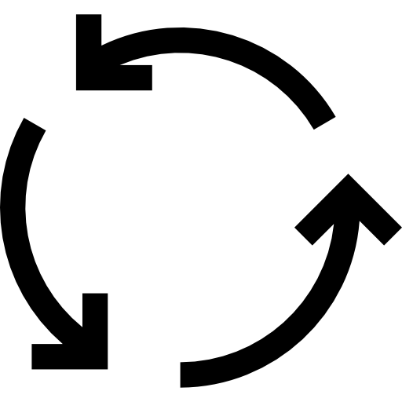
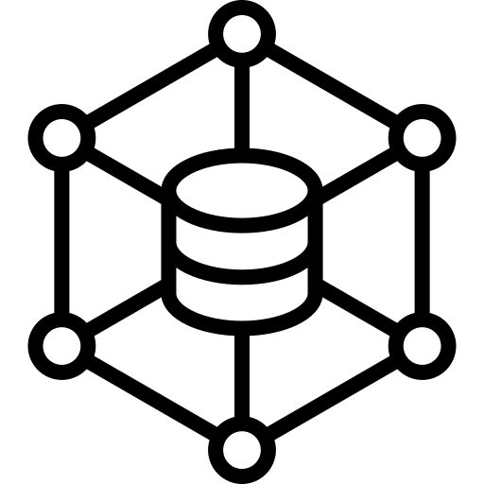

Background: Federated LLM (FedLLM)
[Reference: FlowerLLM, Flower Ltd.]
(1) Democratizing LLMs
(2) Stronger LLMs
Notes:
First of all, I will introduce the background of this work, that is federated llm, we call it as FedLLm.
Different from the previous two papers that focus on the training within a data center.
FedLLM focuses on the federated learning of Large language models across different data centers.
All of the central training, distributed training and federate learning, they can all generate strong large language models to support various downstreaming tasks, such as classification, question and answering, generation and so on.
The uniqueness of federated learning is that it does not collect the data together, instead it transfers the model from one data center to another so as to fully leverage computations all over the world and most importantly, preserve the data privacy so as to leverage more private and personal data leggally.
As a result, FedLLM can democratize LLMs and make stronger LLMs
加一些application

Slide 3
Motivation：FedLLM unique challenge
Huge memory footprint
Notes:
However, such a good vision has some fatal drawbacks.
First, it needs to run LLMs training on the edge devices, which is ususally memory limited.
So Training LLMs will lead to an unaffordable memory footprint.

Slide 4
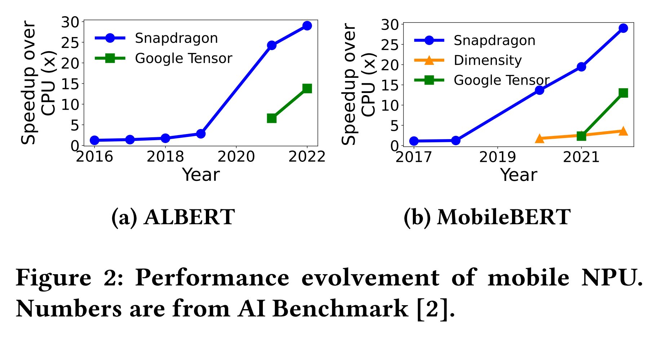
Motivation：FedLLM unique challenge
Huge memory footprint
Incompatible with mobile accelerators
Notes:
And second, is about the hardware compatibility.
As we all know, there are continuously new accelerators on the mobile devices, such as neural processing units NPU.
It can process the data up to 30 times faster than CPU and its speed up adavantge over cpu is nearly linearly incresing over the years.
Ideally, with NPU, we can compute very resource -efficiently on the mobile devices.
However, unfortunatedly, for current NPUs, it does not support many of the training operators.

Slide 5
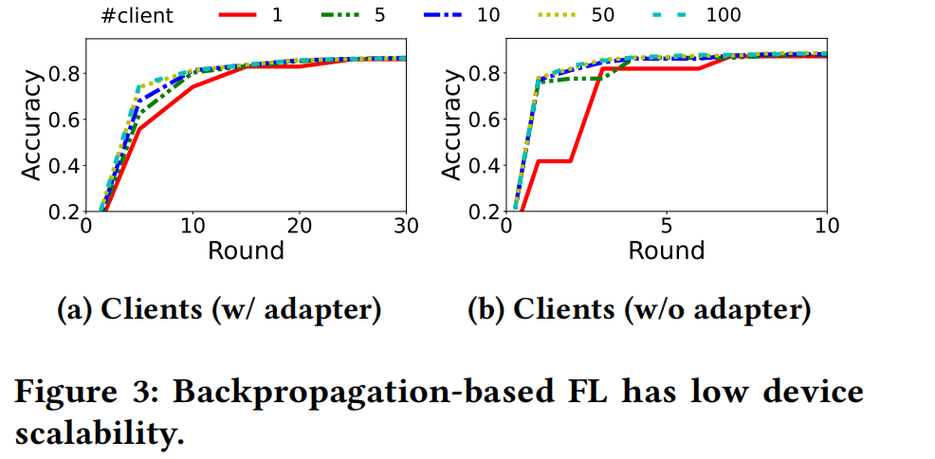
Motivation：FedLLM unique challenge
Huge memory footprint
Incompatible with mobile accelerators
Limited device scalability
Notes:
And last is a special issue for federated learning .
During our experiments, we find that even we have thousans of clients simultaneously, not all of them can contribute to the model training.
For example, using 20 clients per round is enough to saturate the learning knowledge of each gradient updating.
And this issue can be traced back to the scalibility issue of batching.
We have more explanations of this issue in the paper, you can refer to it for more details.

Slide 6
Root: Backpropagation (BP)
They can all be attributed to BP-based gradient computing.
Alternatives: BP-free Training
Notes:
And we attribute all of these issues to the backpropagation-based gradient computing.
Because during inference, we do not have graidient updating right.
and as a result, it's memory usage is smaller because it does not need to store those intermediate activations, it has a better hardward compatiblity with a lot of advanced optimizations from the hardward companies.
So we are thinking about, is there a way that can be an alternative to the BP-based training. Or just say, is there a way to do the BP-free training.

Slide 7

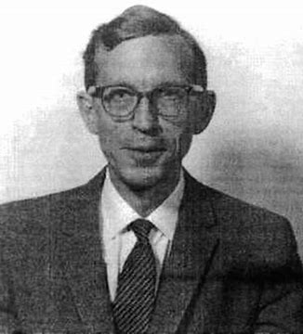
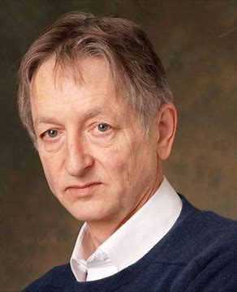




Backpropagation-Free Training
BP-based Deep learning
Charles, 1988
Zero-order opt.
Hinton, 2022
Concurrent work
Estimation of the mean of a multivariate normal distribution.
HSIC
BP-free algo.
…
The Forward-Forward Algorithm: Some Preliminary Investigations
Forward gradient
BBT (for LLM)
Preprint (for FL)
Notes:
Fortunately, previous mathematics literatures have pointed this way out.
As shown in the timeline, I listed the main milestone of BP-free training.
From nineteen eighty-eight， charles first propose the methods that estimate the mean of a multivariate normal distribution.
After that, a seires of zero-order optimizations are proposed and continuously studied. But BP-based methods becomes the mainstream and quickly developed due to its precise gradient computation.
Recently, in 2022, Prof. hinton, who starts the deep learning research, proposes an forward-forward algorithm to re-catch researchers’ eys.
Some new methods that are better fit the deep learning models are proposed after that.

Slide 8
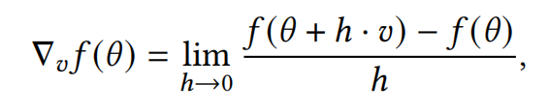
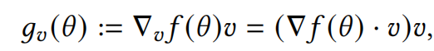
Design: Forward Gradient
Perturbations
Forward gradients
True (BP-based) gradients
Baydin A G, Pearlmutter B A, Syme D, et al.
Gradients without backpropagation
$∇f(θ)={\left[\frac{∂f}{∂θ_{1}},…,\frac{∂f}{∂θ_{n}}\right]}^{⊤}$.
Forward gradient: unbiased estimation of BP-based gradient
Notes:
In this work, we choose one of them, that is forward gradient, as our algorithm foundation.
So let me quick introduce this method.
As you can see, here is the BP-based gradients, or we can just call them as true gradients for simplicity. I skip the detail about how to compute it because we have a lot of materials to ref, right.
And I just want to show how forward gradients can estimate those true gradients.
First, we will generate some perturbations v in different directions.
These are the yellow arrows.
Then we will add those perturbations to the model weights and see how it acts.
The concrete way is to see the variation of the loss funtion F
That means we compute the f(theta plus hv), that is the loss with perturbated weights minus f(theta), that is the original weights, and divide the result by the a very small number h
It is just like a numerical way to compute the directional differential
After that, we multiply the computed directional differential with perturabtion v to gain the forward gradient.
That is a little complex right.
In a word, just do three steps,
1. execute the inference with original model weights, that means without any perturbations
2. generate the perturations
3. execute the inference with perturbated model weights and see the difference.
After that, you will obtain an estimated gradient.
放大一些什么事perturbation

Slide 9
Design: System Overview
Notes:
Atop on forward gradient or perturbated inference, we implement our system fwdllm
As I said, different from traditional backward propagation based federated learning system
forward only federated learning system is memory efficient,
and is hardward-friendly because it only needs to do the inference.
And plus that, it is very scalible from the perspective of involving more clients.
because with more clients, you can have more pertrubations, then you can have a more accurate estimation of the gradient

Slide 10
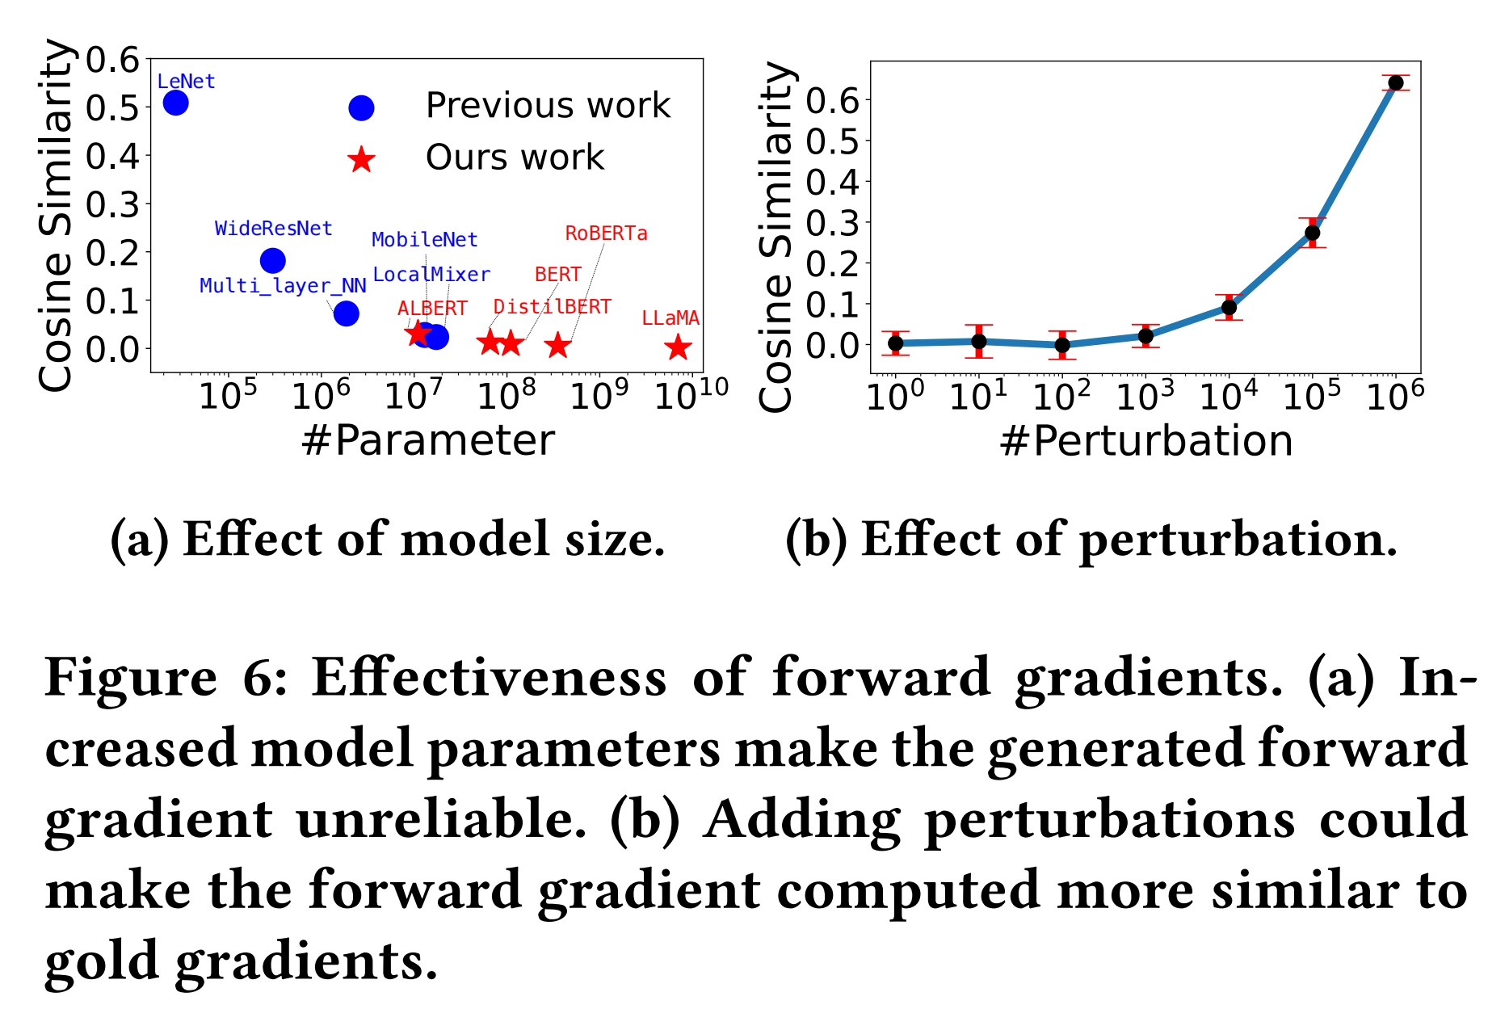
Design #1: Parameter-efficient BP-Free
Previous BP-Free Literatures only apply to tiny models.
Notes:
Now here is the system part challenge.
Though BP-free methods are promising, but none of them has been proposed to apply to large models before.

Slide 11
Design #1: Parameter-efficient BP-Free
Previous BP-Free Literatures only apply to tiny models.
Reason: Number of perturbations are huge.
Notes:
Because the number of perturbations needed are extremely huge.

Slide 12

Design #1: Parameter-efficient BP-Free
Number of perturbations
Hessian rank of Loss
Model size
Previous BP-Free Literatures only apply to tiny models.
Reason: Number of perturbations are huge.
Notes:
Reasons behind are that
the larger the model, the more is the model weights number.
It means a harder task to estimate them.
The only way before is to add more perturbations to gain a stable estimation of the weights
But too many perturbations mean too many inference compuations, that will decrease our system benefits.

Slide 13
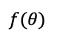
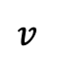
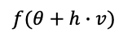
Design #1: Parameter-efficient BP-Free
RAM
Gradient
PEFT
$$v$$
Input
Model
$$f(θ)$$
$$f(θ+h∙v)$$
PEFT
Model
Previous BP-Free Literatures only apply to tiny models.
Reason: Number of perturbations are huge.
Notes:
In these work, instead, we first time integrate the parameter-efficient fine-tuning with the forward-only fine-tuning.
It only updates a small portion of the pre-trained models and leave other parameters untuned.
That decreases the number of weights needing to be estimated.
During implementation, we only load the pretrained model once in the memory persistanly, and update the small fraction of seperated PEFT adapters to help update the knowledge within the model.
The way to update the PEFT adapters is by adding perturbations to it and do the inference one more time.

Slide 14
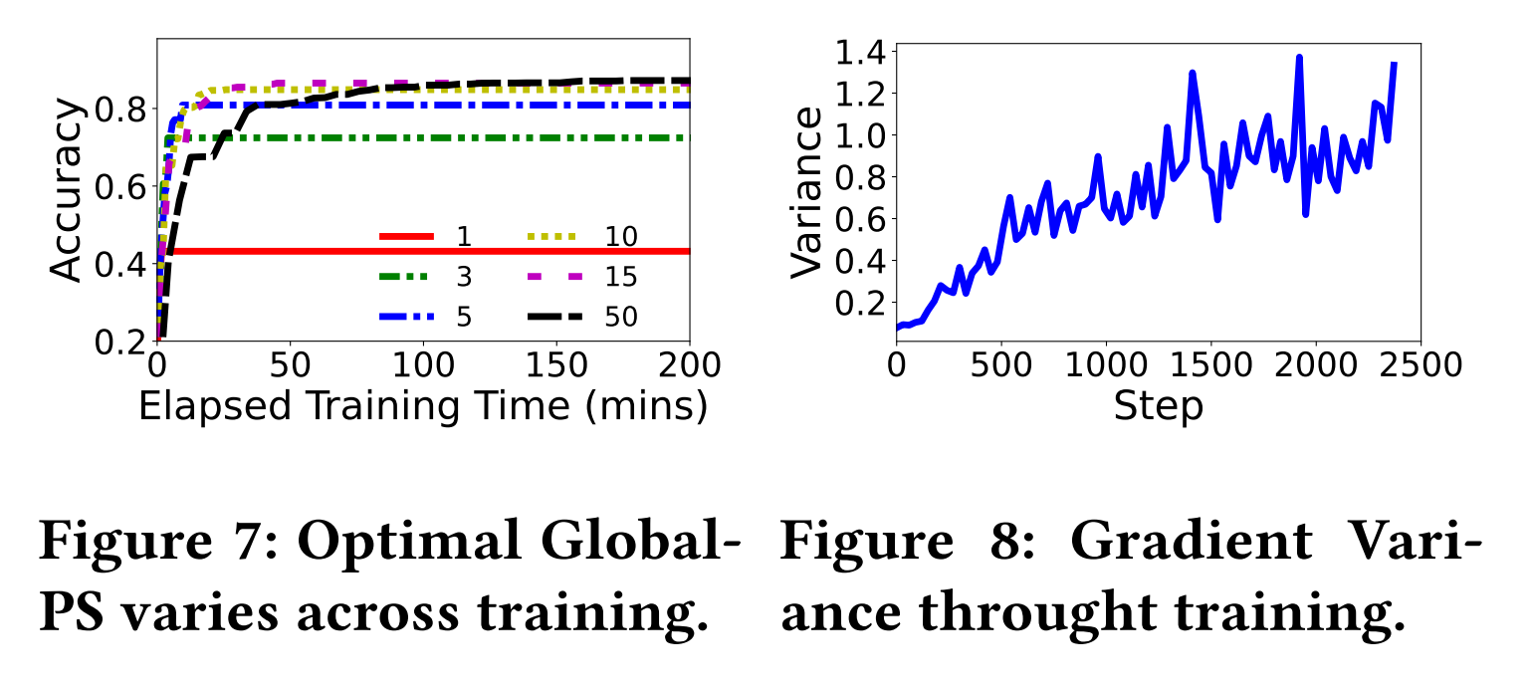
Design #2: Client Workloads Adaptation
How many perturbations？
Notes:
The second design is about the client workload adaption.
The challenge to be further tackled is that, now we have samller pertuabtions to compute, but we still do not know the concret number of it.
And the number of perturbations have a hugh effect on the convergence performance.
As you can see in the figure shown, with smaller perturbation 1 to 5, you can have a sharp accuracy increase in the early training stage, but it will stop at a rather lower convergence accuracy.
In contrast, if you insist using larger perturbations, then you can undoubtedly have higher convergence accuracy, but your convergence speed is slower.
Finding a proper perturabtions numbers is too ad hoc and may even has no optimal answers because it might be optimial to be small in the earky stage and be optimial to be larger in the late stage.

Slide 15
Design #2: Client Workloads Adaptation
Validate?
no
More
perturbation
How many perturbations？
We decide on the gradient variance.
Notes:
To solve this issue, we conduct a lot of offline experiments and find that with the process of training, the variance between computed gradients are becoming stable.
That finding is useful because during perturbated inference-based gradient updating, we have a crateiro to refer.
Once the forward gradients generated, we can compute their variance.
This is a very quick process compared to the model inference.
Then if we find the variance is truning to stable, that means the newly perturbation generated do little help to the estimation, so we stop generate more and conduct the gradient updating.
If not, we include more ..utill

Slide 16
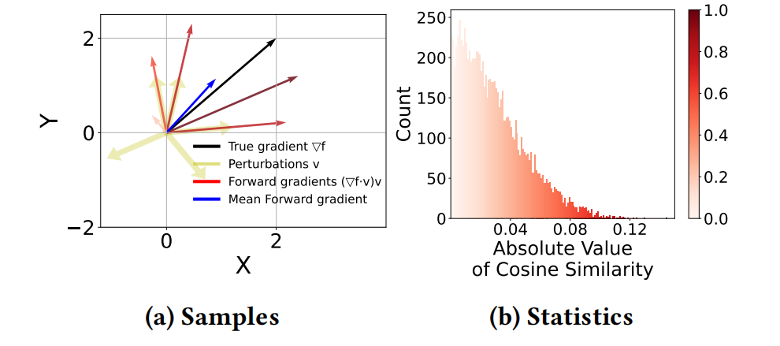
Design #3: Discriminative sampler
Contribute more
Over 60% of computed forward gradients contribute to less than 30% final aggregated gradient.
Notes:
The third design is about...
typically, we need hundreds or even thousands perturbations to have a useable graidient estionamtion.
We dive into those pertuabtions and found that Over 60% of computed forward gradients only contribute to less than 30% final aggregated gradient.
that's is frasutraing because we compute alot in vain
we donot compute to the point

Slide 17
Design #3: Discriminative sampler
Contribute more
Over 60% of computed forward gradients contribute to less than 30% final aggregated gradient.
We propose to filter out those more valuable perturbations.
Forward gradient (n-1)
Notes:
We propose to filter out those more valuable perturbations by only generating the perturbations that are similar to those contribute more when computing the last round forward gradients.
It can save more than 50% pertuabted inference beforehand. For more details, pelase refer to our paper.

Slide 18
Design: Holistic Workflow
Clients workloads
adaptation
Validate?
4
Model
Inference Engine
Forward
gradients
5
3
Aggregate
Seeds&
Updated model
Discriminative
gradient sampling
Dataset
6
1
2
FwdLLM Server
FwdLLM Clients
Notes:
So here is our combined system workflow.
First cloud will generate some seed and send to the client together with the pretrained model
Then the client will sort out those more useful seeds to generate useful pertuabtions by using the information of the last round.
Then the client conduct inference using the pertubated model.
Client and cloud will coopertate to validate wheter the global pertuabetions are enough to estimate thise round‘s gradient.
Once the validation is detected, final forward gradients will be sent to the cloud for aggregation.

Slide 19
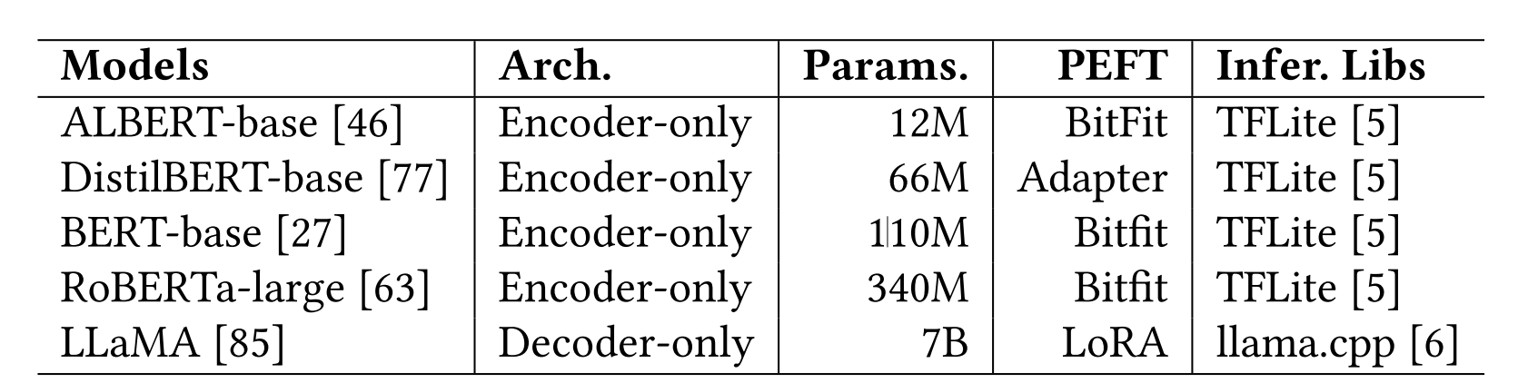
Evaluation: Setup
Model:
Dataset:
Discriminative (YAHOO, AGNEWS, YELP-P)
Generative (SQUAD)
Baselines:
Vanilla Backpropagation-based Federated LLM Fine-tuning (Full-FT)
Parameter-efficient FedLLM Fine-tuning (Adapter, BitFit, LoRA)
Optimized Parameter-efficient FedLLM Fine-tuning (FedAdapter)
Notes:
We implement this system and evaluate it on 5 models, from the subblilion models ALBERT,…
To Biliion sized model LLaMA
To demonstrate the system efficiency and scalability, we conducte experiemnts on both discriminative tasks and generative tasks, with 4 datasets evaluated in total
We include three types of baselines, including
vanilla.. Parameter-efficient BP-based FedLLM Finegyuning, we include three popular PEFT methods
And the optimizated BP-based system Fedadapert that automatically decide the peft configurations.

Slide 20
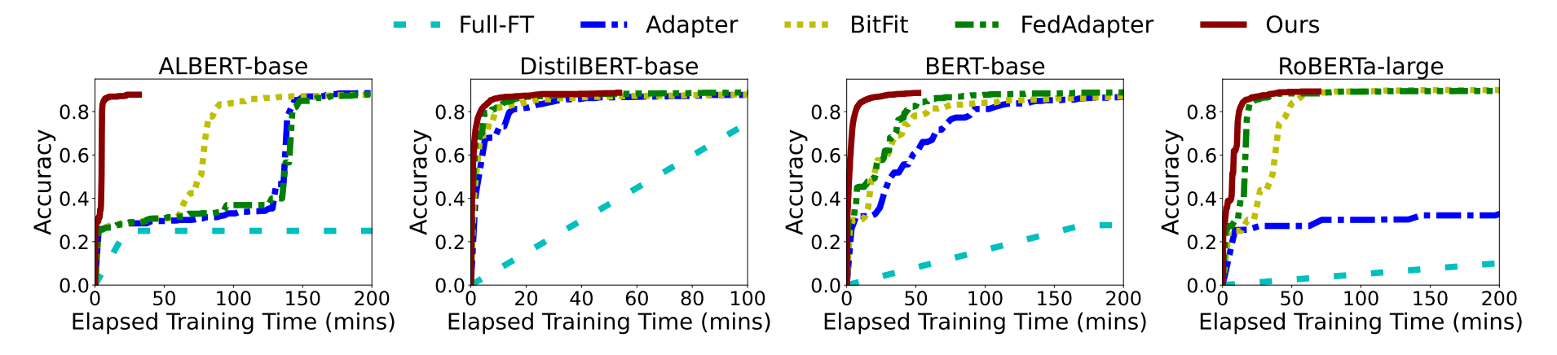
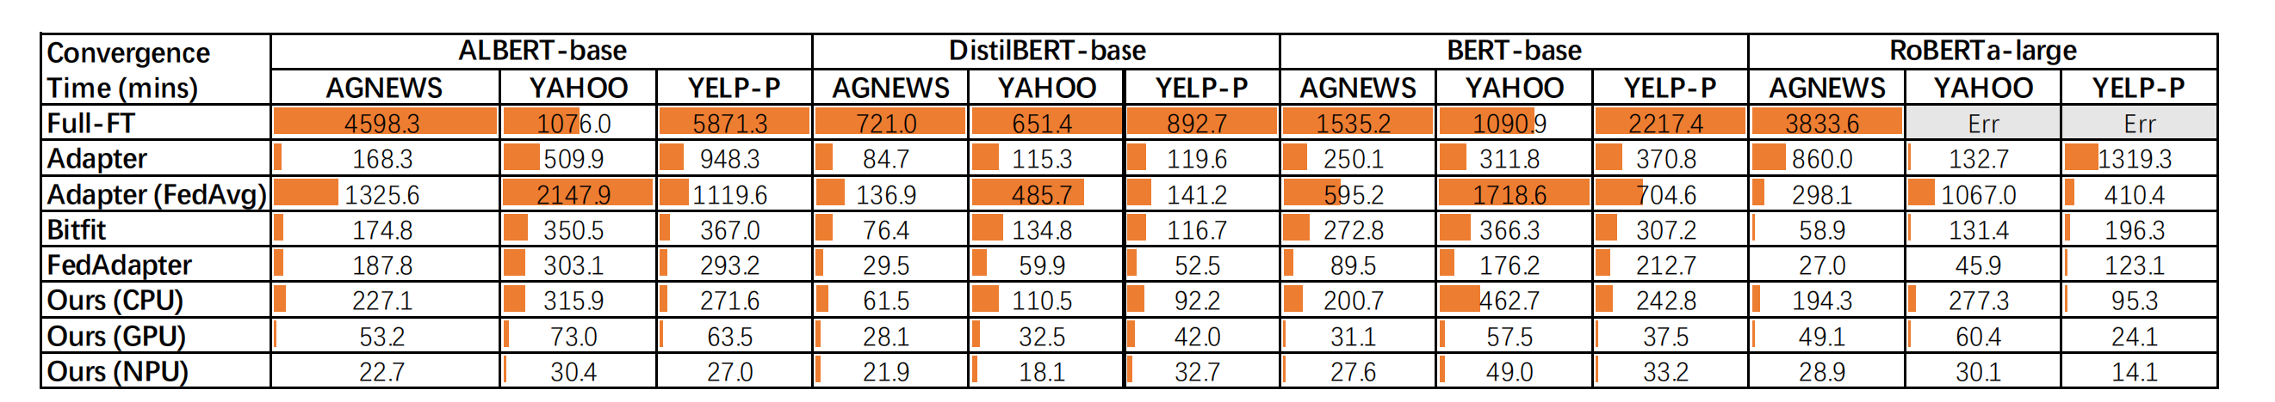
Evaluation: End-to-end Performance
FwdLLM achieves significant improvements with mobile NPU. (up to 132x)
FwdLLM is versatile across different processors and hardware boards. (GPU: 92x; CPU: 21x)
Notes:
Here is the evaluation results,
First, as shown in the upper figure, we can see that FwdLLM achives more than 100 times convergence speed up, because it can be compatible with mobile NPUs, but Tratidional BP-based mehods can not utilize NPU but only can use GPUs
Second ,we show that even with GPUs, our system can still outperforms baselins non-trivially.
For example, when both using CPU, fwdLLM can converge 20 times faster than BP-based training baselines.
That shows the benefits not only come from the accelerated processors, but also the optimized training system itself.
数据是仿真的，
Cite 大亮的npu的mllm的框架，放一个链接
Arxiv 是否online

Slide 21
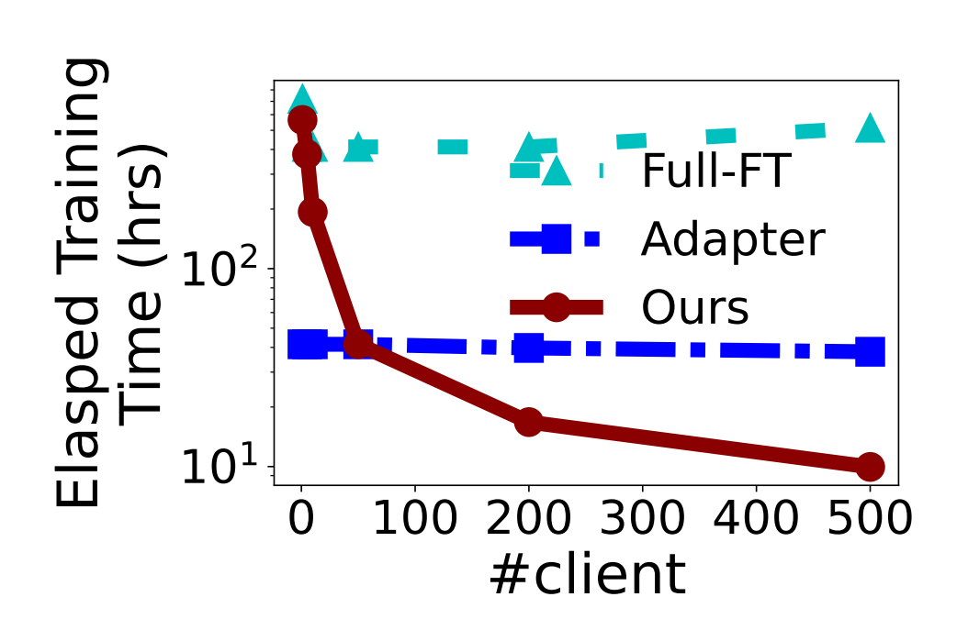
Evaluation: Different Client Number
50 clients are enough to surpass BP-based methods.
More clients increase the convergence speed continuously.
Notes:
Second part of evaluation is about different client numbers
As you can see in the figure, red lines are our BP-free training system performance,
Generally, it needs 50 clients to converge faster than BP-based methods because it needs about 100 pertubations to valiate the perturbations
After that, our BP-free system can still earn benefits from the increase of the clients, but for bp-based baselines, they will not.

Slide 22
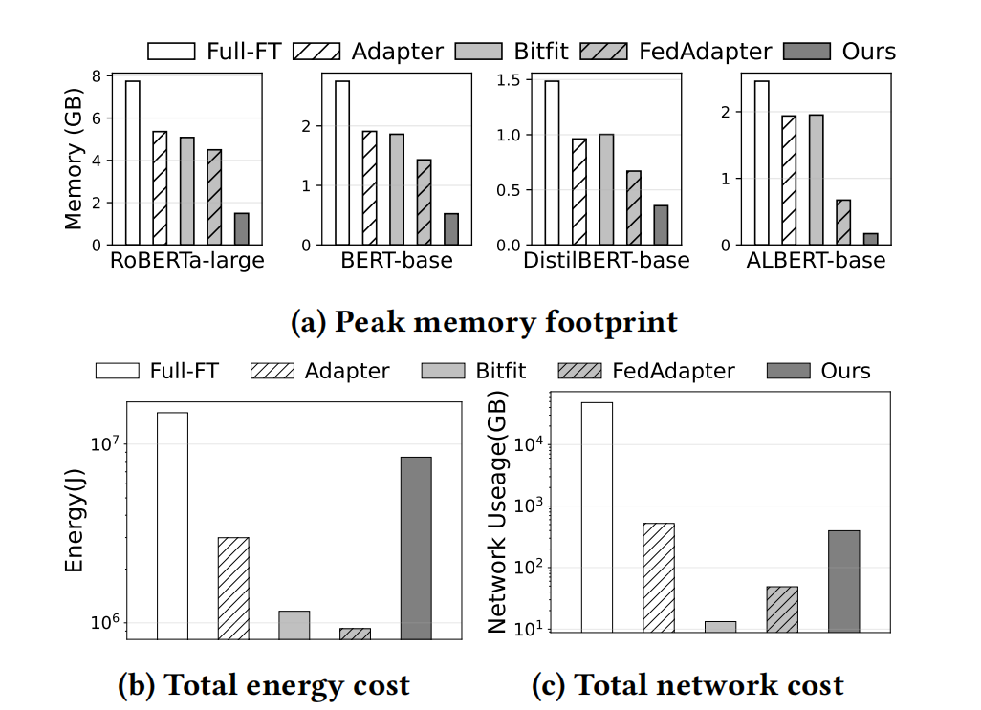
Evaluation: System Cost
Up to 93% memory reduction
Higher energy cost than PEFT (100 times more client involved)
Notes:
Third part is the resource cost of our system.
The most significant improvement of our system is the memory reduction.
we can reduce more than 90% of memory comparaed to baselins because
Please remember we do not include any quantization techniques but are totally orthogonal to then.
This is a very promising research direction to make FedLLM fine-tuning happen on more clients, including those extreme memory-limited devices.
like TEE execution environment, MCU or something like that
One negative result is about the energy cost.
Though the convergence time can be amortized by the concrueent client running, they produce real energy that cannot be dismissed. However, we expect this issue can be solved with the development of the NPU processors.

Slide 23
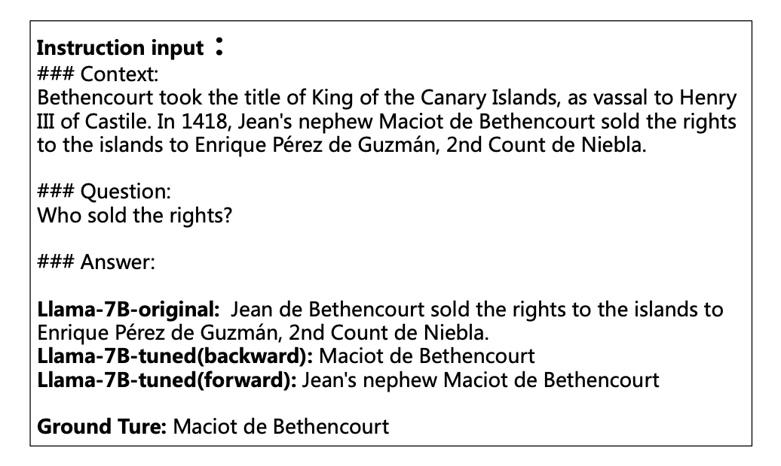
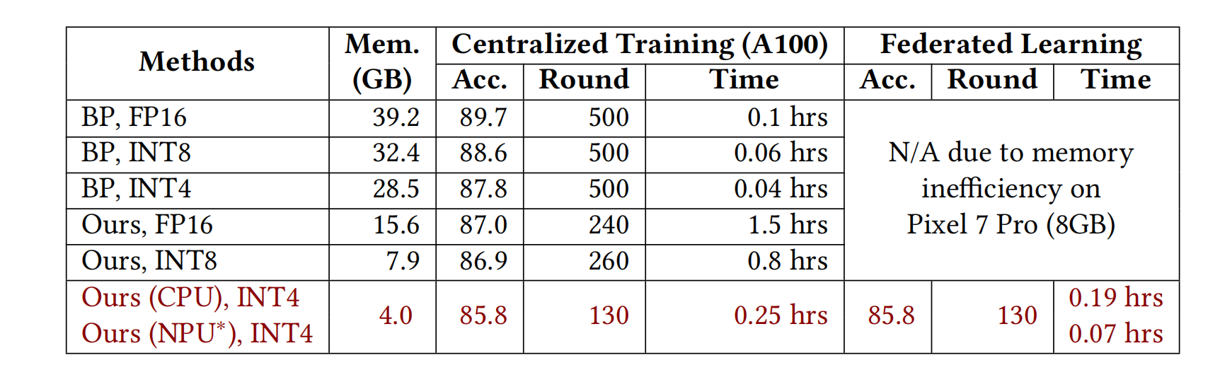
Evaluation: Extended to LLaMA
First implemented billion-sized FedLLM fine-tuning on mobile phones (CPU).
Similar performance to BP-based baselines.
（Vision）with NPU, FwdLLM converges with the same speed as central training.
Notes:
Final part is the evalution of our suysem on the billion-sized LLaMA.
It demonstrates that our systsme is promising to be deployed to almost all FedLLM training scenairos where BP-based methods can do.
As you can see the forward-only fine-tuned model can generate simialr sentence as the model trained by BP-based federated learning
And with NPU simulation, we show the promising vision that FwdLLM, training in a federated learning way with weaker training devices and longer transmission distance compared to the central, can still converge with the same speed as central training,
That means in the future, federated learning might be also widely deployed, just like what cloud computing is doing now.

Slide 24
Conclusion
FedLLM
FwdLLM: the First Forward-only FedLLM
Memory Efficient
NPU Friendly
High Scalability
Beyond LLaMA-7B
More Models?
Mobile Applications?
Forward-only
High scalability
First Fed LLaMA
Notes:
Finally,
WE introduce the FedLLM and its challengs
WE propose FwdLLM, built atop..
We have a servses of optimzationsi include parameter –efficient BP-free, client workloads adaptations and discriminative pertuabtion samplers.
With all design combined, we achiver memory efficient, NPU freidenly, and high client scalability fedLLM tuning system without backpropagation.
We demonstrate its efficiency on LLaMA and believe it can be appliced to more models and be a trigger to more federated mobile appilcations or even general mobile training in the future.

Slide 25



Thanks for your listening!
mllm
mllm-NPU
Contact: Dongqi Cai (cdq@bupt.edu.cn)
Notes:
That’s all technical part of our work. The final slide is about our code, we have earned three badges to confirm the reproducible of our system.
And we also have an self-developed, open-sourced mobile inference engine to delopy our system into real mobile devices.
Recently, we have realsede the NPU inference support for LLMs in our engine, please scan the QR code to try our codes. Thnaks for listeninbg and I will be happy to answr any questions.
数据是仿真的，
Cite 大亮的npu的mllm的框架，放一个链接
Arxiv 是否online

